Slide 1
Progress Report: Quantifying Spasticity
Charles Wu
with Olivia Sutton and Tony Wang
Client: Dr. Jack Engsberg
1

Slide 2
The Need
A device that can accurately quantify spasticity for cerebral palsy patients
2
Notes:
Incorporate MAS into need

Slide 3
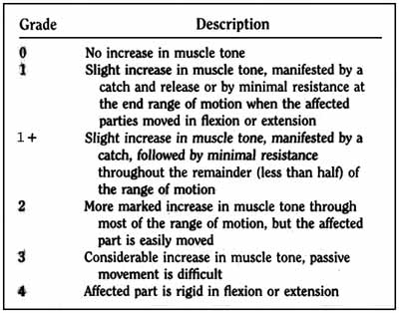
Modified Ashworth Scale
Description: Current standard examination that qualitatively characterizes spasticity
Pros:
Cheap, convenient, easy, versatile
Cons:
Very inaccurate and unrepeatable
Hard to gain the intuition required to perform well
American Academy of Orthotists and Prosthetists, 2013
3
Notes:
Olivia

Slide 4
Project Scope
Design a device (hardware+software) needed to measure the three major parameters that factor into spasticity: range of motion, velocity, and force
4

Slide 5
Chosen Design Features
Characteristic | Specification
Cost | Less than $200
Portability | Does not require external power supply.
Accuracy | Able to distinguish between at least 5 categories of spasticity
Reliability | Less than 10% error between repeated trials of the same patient on the same joint
Characteristic | Specification
Versatility | Must accommodate a shin or wrist ranging from 15 cm to 45 cm in circumference
Size | Ideally no larger than 21.6 x 19 x 5 cm
Training | Must not require more than 10 minutes of training for a physician to effectively use.
Ease of Use | Must have a simple interface and a corresponding test that can be quickly performed
5
Notes:
Olivia: Explain each of the categories on this slide and the justification. Same for next slide.
briefly mention (~5 points) might not need justification
Because the currently used test is free of charge, the proposed device must be very inexpensive for a clinic to be willing to purchase it.
Must be easily transported between patient rooms to eliminate patients having to travel to a separate room to use the device.
The device must have at least this level of accuracy in order to be an improvement over the Modified Ashworth Scale.
In order to be considered a repeatable measurement, this must be true.
The device must be versatile enough to use on limbs of patients in early childhood to adulthood, regardless of weight. It should also be compatible to both arm and leg spasticity.
Fits within the physician's labcoat pocket.
For a physician to be willing to convert from the Modified Ashworth Test, it must be intuitive enough to pick up and use.
As the Modified Ashworth Scale takes something on the order of minutes, the device must have the ability to be operated swiftly and with ease.

Slide 6
Design Alternatives
Range of Motion
Velocity
Resistive Force
6
Notes:
Olivia: basically talk about that there are three quantities that need to be measured, and that they can’t all be necessarily measured by the same device since force cannot be calculated by using simply the mass of the leg and the acceleration

Slide 7
Range of Motion and Velocity
Sensing Devices
Xbox Kinect
Dartfish
Accelerometer
Smartphone Accelerometer
7
Notes:
Olivia:
Note that velocity and range of motion devices are considered together. This is because the way these two quantities are measured can be easily coupled.
The four devices

Slide 8
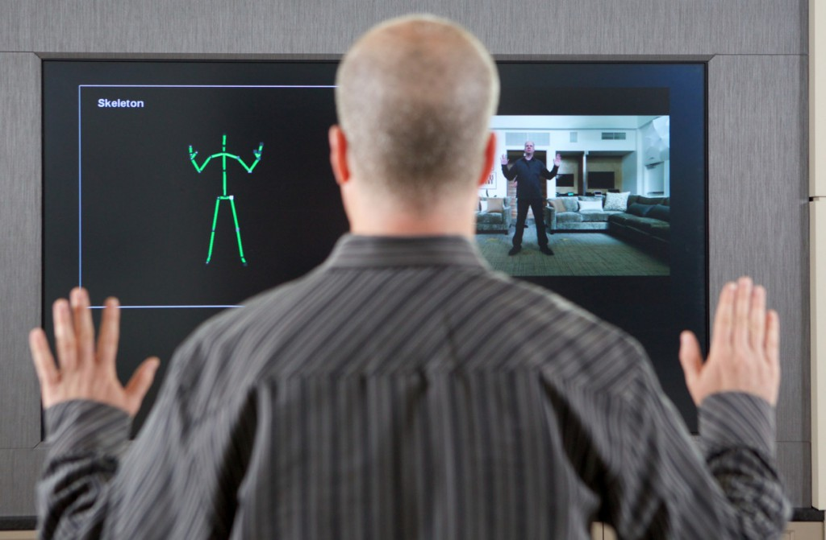
Xbox Kinect
Description: Camera system that can connect to a computer to track and record movement
Pros:
Easily connected to any computer
Cons:
Lacks portability
Physician performing test may make it inaccurate
Medical Expo (2014)
8
Notes:
Olivia

Slide 9
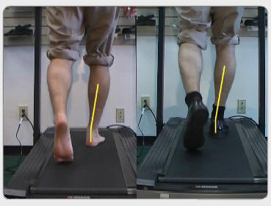
Dartfish
Description: Software program that analyzes a recorded video and has the ability to track arm or leg movement
Pros:
Accurate and reliable
Can be used on many platforms
Cons:
Expensive (>$1000)
Not portable and long time associated with each test
Ambra Solutions (2014)
9
Notes:
Olivia

Slide 10
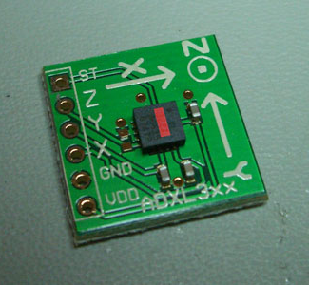
Accelerometer
Description: A device that is able to measure acceleration due to gravity
Pros:
Cheap and easily portable
Easy for physician to use
Cons:
An additional component to the hardware
Less accurate
Protolab (2007)
10
Notes:
Charles

Slide 11
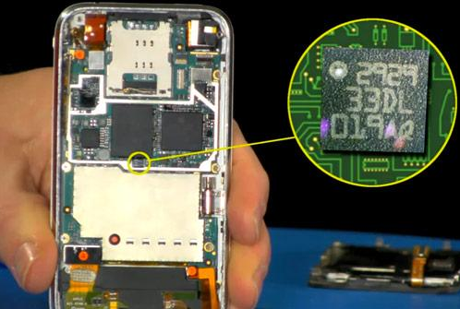
Smartphone Accelerometer
Description:
Silicon-based accelerometer chip seated inside center of phone
Measures proper acceleration
Pros:
Reliable; relatively small and light
Most clinicians already carry a smartphone with them
convenient; no addition cost
Software is Java-based, lots of programming support
Cons:
Less accurate
http://www.engadget.com/2012/05/22/the-engineer-guy-shows-how-a-smartphone-accelerometer-works/
11
Notes:
briefly explain why average velocity might be an issue

Slide 12
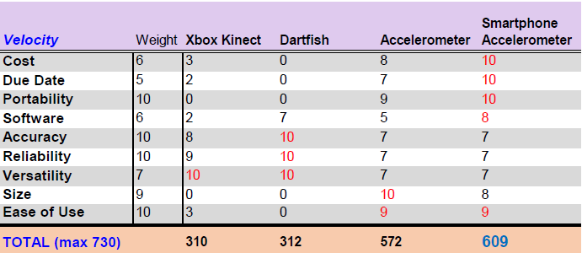
Velocity
12

Slide 13
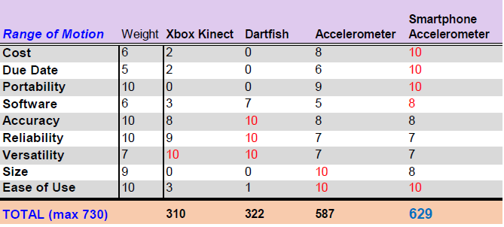
Range of Motion
13
Notes:
Olivia

Slide 14
Force Measurement Devices
Stretch Transducer
Strain Gauge
Force-Sensing Transducer
14

Slide 15
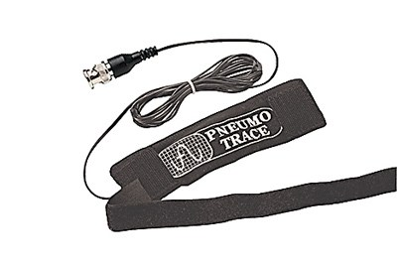
Stretch Transducer
Description: Type of force transducer that changes resistance when physically stretched
Pros:
Versatile
No risk of losing force data
Cons:
Expensive
Difficult for a physician accustomed to the Modified Ashworth Scale test to use
15
Notes:
Olivia

Slide 16
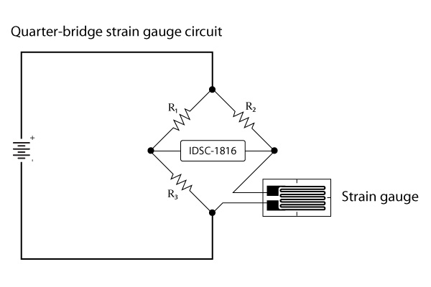
Strain Gauge
Description: Type of force transducer that measure strain by detecting amount of deformation on a material
Pros:
Less complex hardware
Accurate and easily portable
Cons:
Expensive
Many variabilities and prone to errors
Amplicon Systems (2014)
16
Notes:
Charles

Slide 17
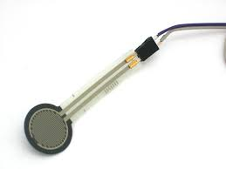
Force Sensing Transducer
Description: Type of force transducer that changes resistance when pressure is applied onto sensor
Pros:
Accurate
No moving parts on hardware
Cons:
Need a unique hardware design
Adafruit (2014)
17
Notes:
Charles

Slide 18
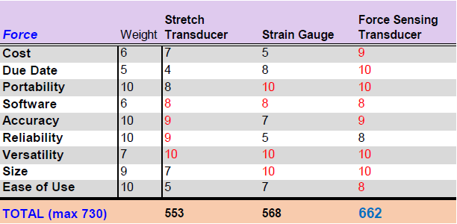
Force
18
Notes:
Just summarize the three devices and why force sensing resistor wins out
change force sensing transducer

Slide 19
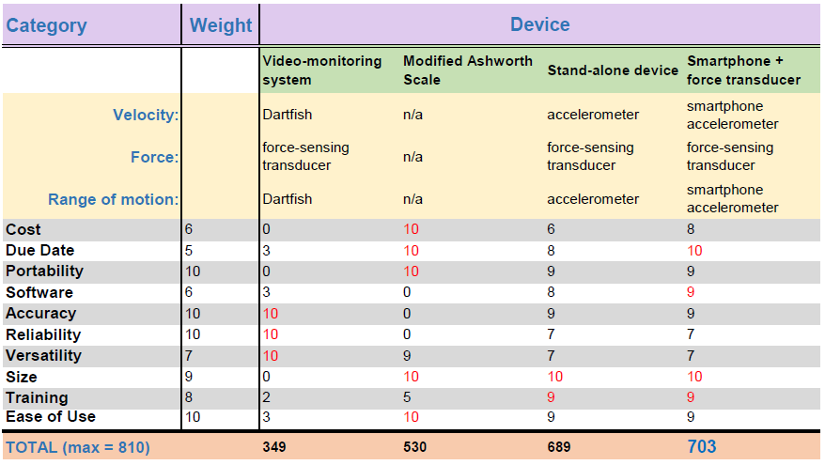
Chosen Final Design
19
Notes:
Charles

Slide 20
Chosen Final Design
Smartphone + Force Sensing Transducer
Hardware:
All the force measured on active force sensing area
Size no larger than physician pocket
Secure Smartphone
Software:
Centralized location for data processing
20

Slide 21
Chosen Final Design
Smartphone + Force Sensing Transducer
More hardware specifics:
Intuitive use for physicians
Flexible metal with foam to increase comfortability
Aesthetically pleasing
21

Slide 22
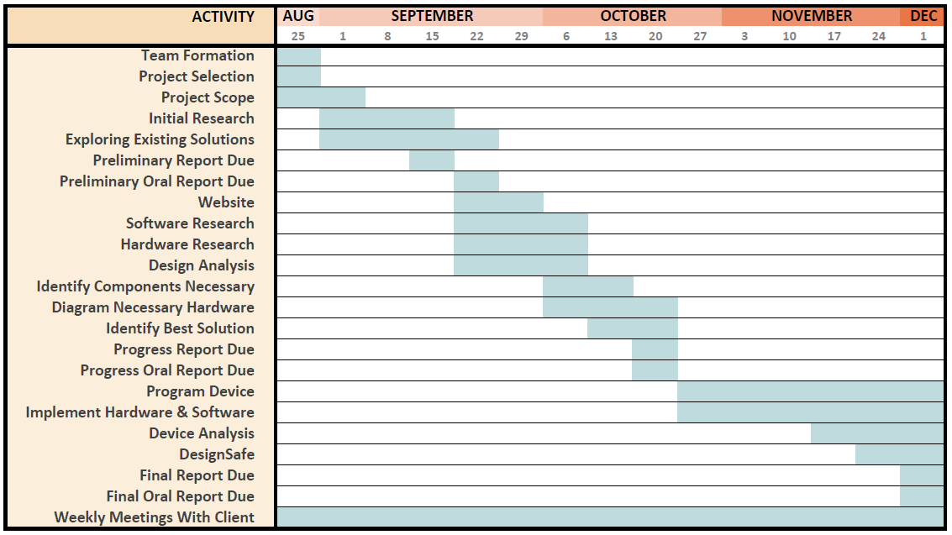
Updated Design Schedule
22

Slide 23
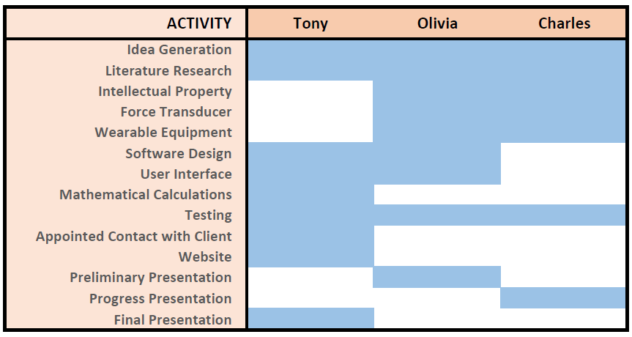
Updated Team Responsibilities
23

Slide 24
Acknowledgements
Dr. Jack Engsberg
Olivia Sutton
Tony Wang
Dr. Joseph Klaesner
Anna Boone
Dr. John Standeven
24

