Slide 1
Spasticity Quantification
Preliminary Report
Olivia Sutton
with Tony Wang and Charles Wu
for client Dr. John Engsberg
1
Notes:
THINGS STILL NEEDED:
TONY: Edit the existing solutions slides
CHARLES: DO SLIDE 20 [I went ahead and edited the EMG slide for you :)]
OLIVIA: add slide numbers (DOES ANYONE KNOW HOW I CAN’T FIND IT AHHH)

Slide 2
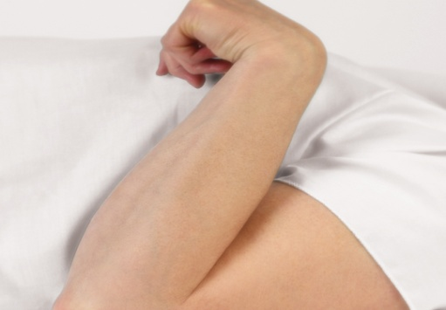
What is Spasticity?
Spasticity: A velocity dependent resistance to passive stretch
Cerebral Palsy (CP): 1/500 children are
affected. Of those, 80% experience
spasticity (NIH, 2014)
Physiofunction, 2013
2

Slide 3
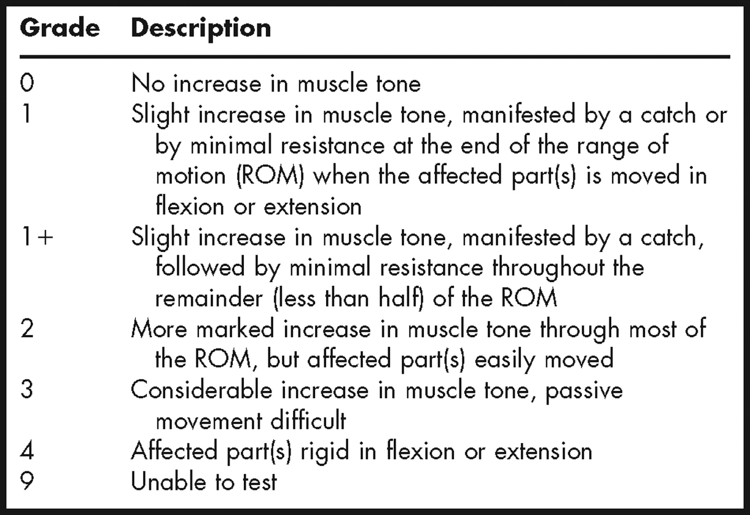
How do you measure it?
Modified Ashworth Scale
American Academy of Orthotists and Prosthetists, 2013
3

Slide 4
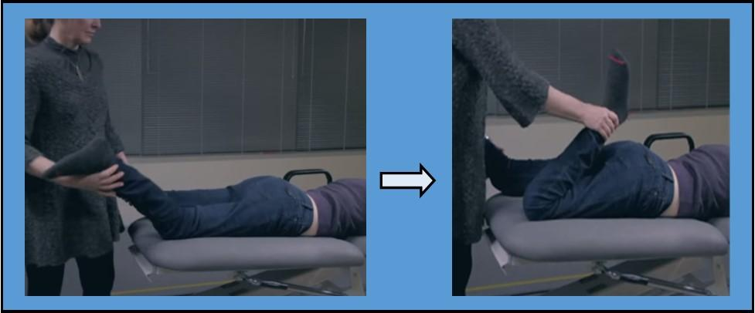
How do you measure it?
Modified Ashworth Scale:
Physician stretches leg over range of motion at varying velocities
Subjectively rank spasticity on scale of 0 to 4
SCIREproject, 2014
4

Slide 5
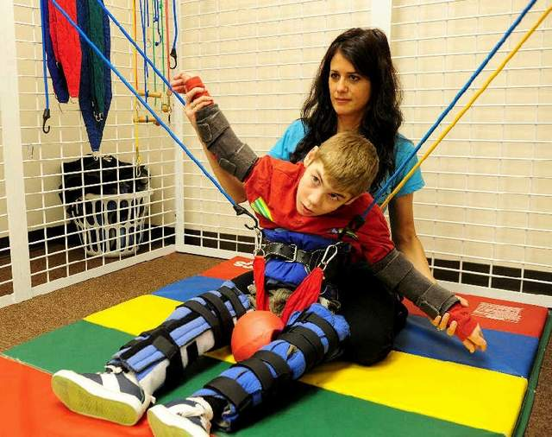
Why do we need to measure it?
Treatment is a spectrum from physical therapy to invasive surgery
Measure of spasticity necessary for objective treatment planning
Andrusko, 2013
5

Slide 6
Project Scope
Design a device or software needed to measure the three major parameters that factor into spasticity: range of motion, velocity, and force
6

Slide 7
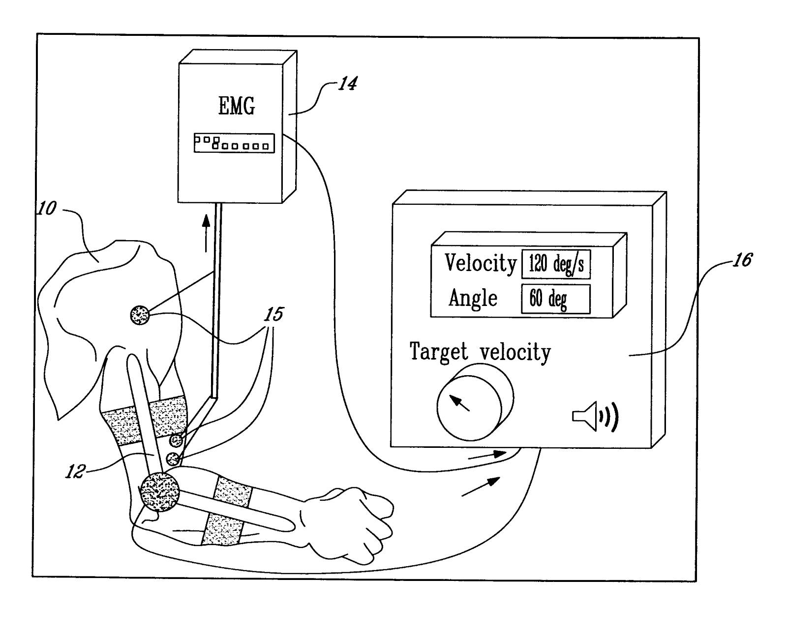
Existing Solutions - Electromyography Measurements (EMG)
EMG
Test:
EMG electrodes and goniometer used on joint
Results:
output real-time velocity and angle measurements
Limitations:
Fickle system, precise setup. Some setups are static tests for a dynamic process
Patent US20080312549 A1
7

Slide 8
Existing Solutions - Objective Spasticity Measure
Ansari, N. 2007:
Test:
Move arm through constant force, measure velocity reduction
Results:
Patients with higher spasticity have a higher reduction in velocity
Limitations:
Study fails to accurately measure patients in upper ranges of spasticity
Measuring instantaneous velocity with high degree of accuracy is difficult in clinical setting
8
Notes:
1) test. 2) results 3) why it fails

Slide 9
Existing Solutions - Objective Spasticity Measure
Peng, Q. 2011:
Test:
Move ankle joint up and down through its range of motion, measuring force and orientation
Results:
Plot force vs. angle and observe “catch”
Limitations:
Provided comprehensive data, but failed to arrive at measurable scale to quantify degree of spasticity
9

Slide 10
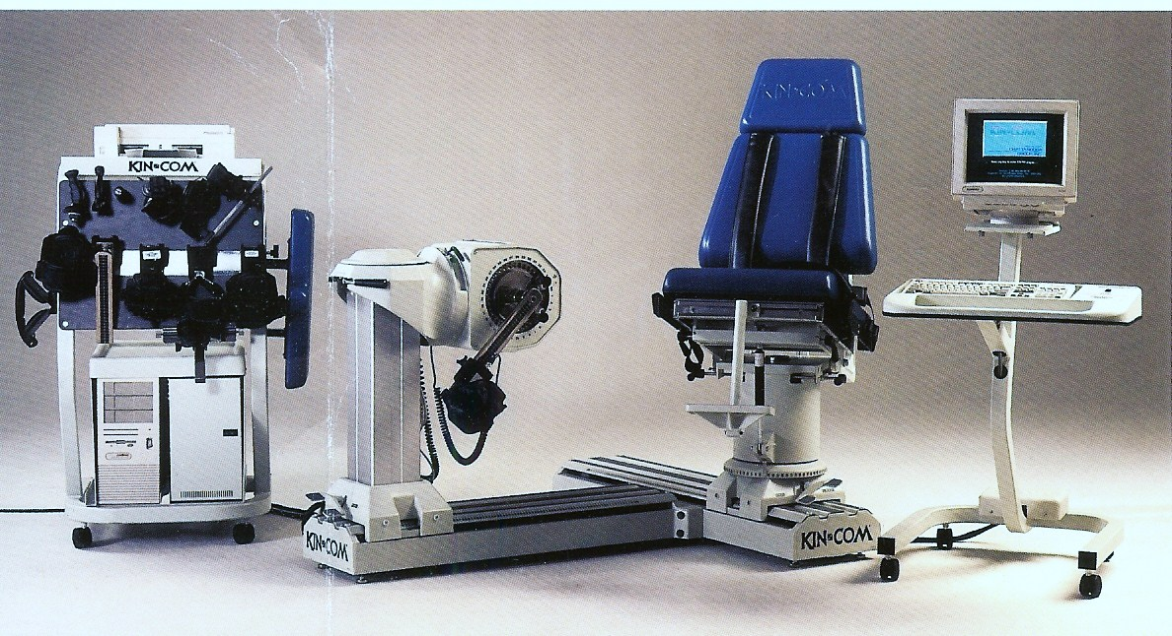
Existing Solutions - Objective Spasticity Measure
Engsberg, J. 1996:
Test:
Rotate leg about the knee joint at constant velocity, tracking the force required through entire range of motion. Calculate total work done by leg at various velocities
Results:
Normal patients: 0
Spastic patients: >0
More spastic → higher rating
KinCom Corporate Website, 2011
10
Notes:
In this last quantitative study, the leg was rotated about the knee joint at constant velocity using a KinCom dynamometer, while the force at any given time was tracked. The patient sits in the chair with their leg strapped into a dynamometer, which can move the leg at a regulated constant angular velocity. From this, the total work was calculated at various velocities.

Slide 11
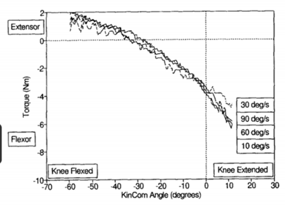
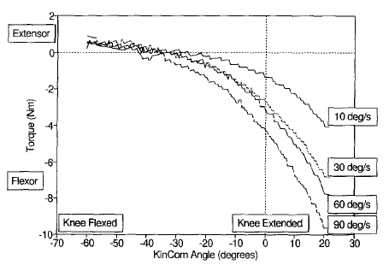
Objective Spasticity Measure
Engsberg 1996 (cont)
Non-spastic Patient Torque-Angle graph, for different angular velocities
Spastic Patient Torque-Angle graph, for different speeds
11
Notes:
The slope of the resulting work-velocity graphs in this study can be used to quantify different degrees of spasticity. Normal patients would have a rating of 0, and spastic patients would have a rating greater than 0, with the magnitude directly correlated to the degree of spasticity. In other words, the more spastic the patient, the higher the rating would be.
These torque-angular velocity graphs demonstrate the data acquired directly from the dynamometer. On the right, a spastic patient is shown, where for increasing velocity, there is an increasing amount of torque exerted to restrict the joint angle from increasing. On the left, it can be seen that for a non-spastic patient, there is no variance in these values.
Although this study successfully created a quantitative measure of spasticity that is a huge improvement over the Modified Ashworth Scale, the KinCom machine needed to do so was very expensive, on the order of hundreds of thousands of dollars, and the time needed to conduct the test is too great for the method in this study to be clinically feasible.

Slide 12
Design Requirements
Characteristic | Specification
Weight | Less than 1 kg
Size | No larger than 21.6 cm x 19 cm x 5 cm
Cost | Less than $200
Portability | Easily transported between patient rooms Does not need constant external power supply
Battery Life | Must not require charging over a period of 8 hours
12
Notes:
So, in order to make sure the device our team builds not only works, but is clinically feasible, we have to pay attention to a lot of different design requirements, including
weight of this device, which has to be less than 1 kg to allow the physician to easily use it on the patient,
size of the device, which has to be no larger than 21.6 cm x 19 cm x 5 cm, which is the average size of the physician’s pocket
cost, which has to be less than $200, since the most widely used clinical test currently costs nothing
The device has to be easily portable so that it can be easily transported between patient rooms and it does not need a constant power supply and simple for the physician to use
and tthe battery life must not require charging over a period of 8 hours (the average workday), assuming the device is used on one patient every 30 minutes at maximum

Slide 13
Design Requirements
Characteristic | Specification
Ease-of-Use | Will not require more than 10 minutes of training for a physician to effectively use.
Usage Time | Length of test for a single joint should not take more than 5 minutes
Data Storage | Less than 0.3 megabytes per test
Accuracy | Able to differentiate between different levels of spasticity more accurately than the Modified Ashworth Scale
Precision | Less than 10% error between repeated trials of the same patient on the same joint
13

Slide 14
Data Transmission¹
 | Bluetooth | Wi-Fi
Frequency | 2.4GHz | 2.4, 3.6, 5 GHz
Cost | Low | High
Bandwidth | Low (800 Kbps) | High (11Mbps)
Hardware Requirement | Bluetooth adaptor | Wireless adaptors
Range | 5-30 meters | 32 meters indoors
Power Consumption | Low | High
Bit-rate | 2.1 Mbps | 600 Mbps
1. "Bluetooth vs. Wi-Fi." Bluetooth vs Wi-Fi. http://www.diffen.com/difference/Bluetooth_vs_Wifi
14

Slide 15
Preliminary Analysis - Data Transmission Calculations
Data Transmission Speed:
300kb of data per test
800kb per second bandwidth (Bluetooth)
300/800 = 0.375 seconds for data transmission
11,000kb per second bandwidth (Wireless)
300/11,000 = 0.027 seconds for data transmission
15

Slide 16
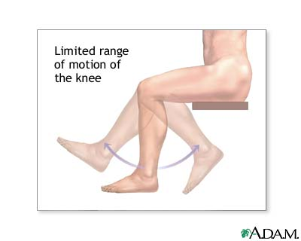
Preliminary Analysis: Components of Spasticity
Range of Motion
Velocity
Force
University of Maryland Rehabilitation and Orthopedic Institute, 2008
16

Slide 17
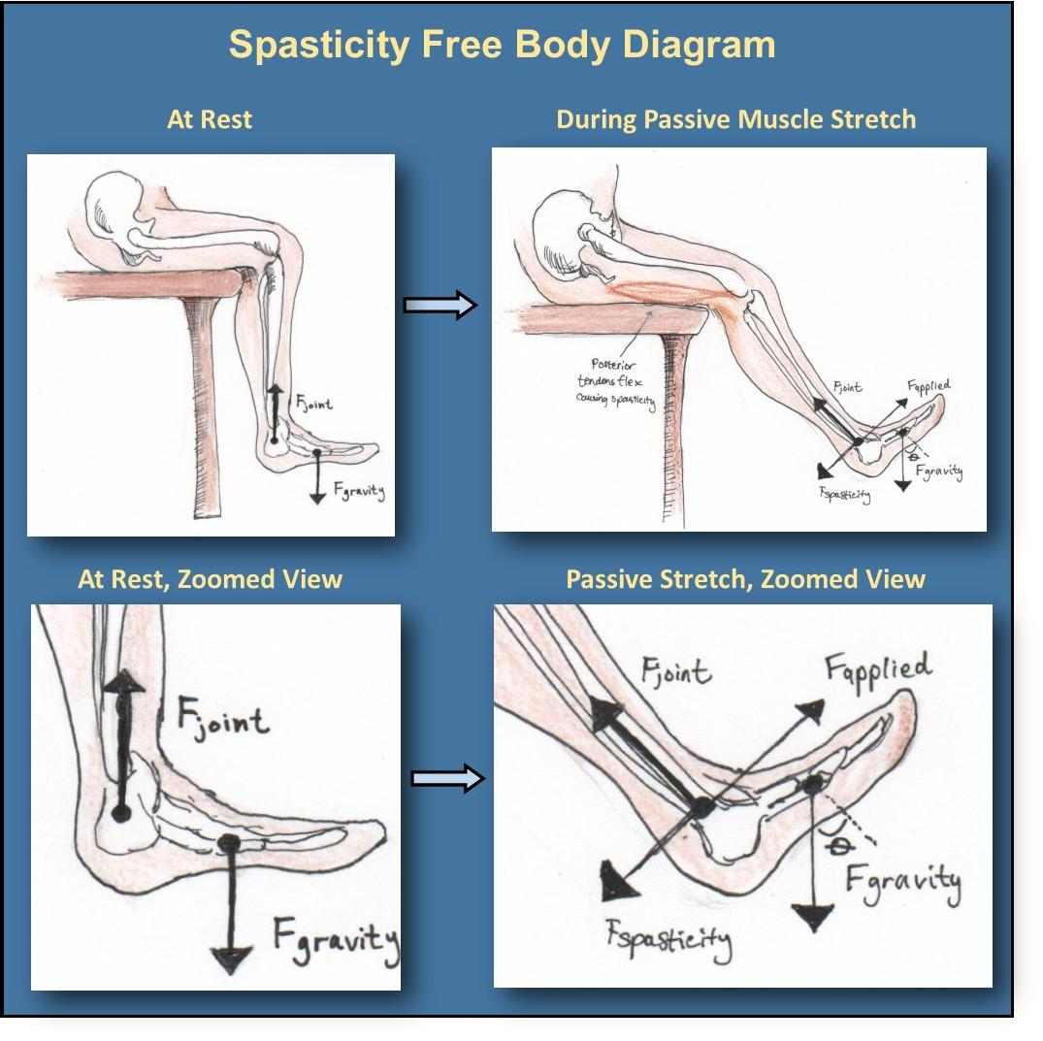
Preliminary Analysis
F_{gravity} = F_{joint} (1)
F_{gravity}*cos(θ)=F_{joint} (2)
F_{spasticity}+F_{gravity}*sin(θ)=F_{applied} (3)
17

Slide 18
Preliminary Analysis
F_{gravity} = F_{joint} (1)
F_{gravity}*cos(θ)=F_{joint} (2)
F_{spasticity}+F_{gravity}*sin(θ)=F_{applied} (3)
18

Slide 19
Preliminary Analysis
For a spastic patient’s foot moving at an angular velocity of 60 deg/s extended at 70 degrees from vertical:
F_{g} = (5.8%)(25 kg)(9.8 m/s²) = 14.21 N
F_{applied} = 26.67 N (measured)
F_{joint} = Fg*cos(70)
F_{joint} = 4.86 N
F_{spastic} = F_{applied} - (F_{g}*sin(70))/2
F_{spastic} = 19.99 N
19
Notes:
Tentatively here’s what I’d say:
Here are some approximate real world values for this scenario. The force of gravity calculated by approximating the weight of the leg as 5.8% of the total body mass. My weight is plugged in for examples sake. Applied force is also a value that we will have as given when doing this calculation. The joint force and spastic forces can then be directly calculated, giving us the result we needed.

Slide 20
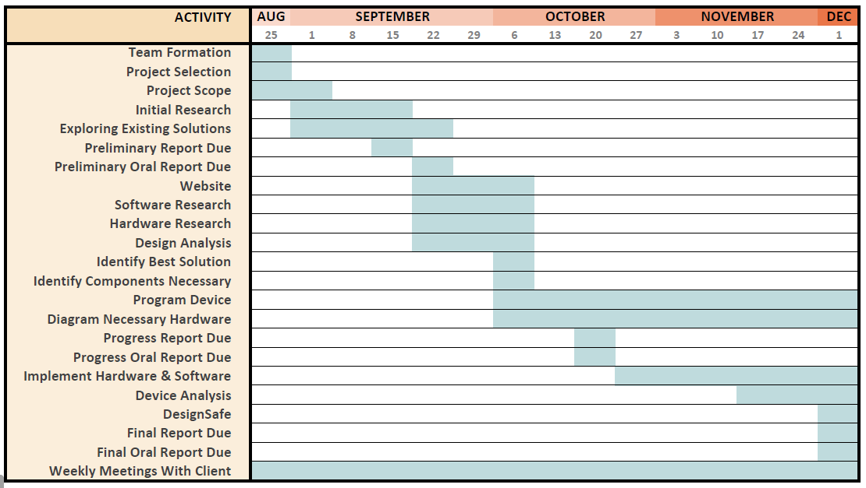
Design Schedule
20

Slide 21
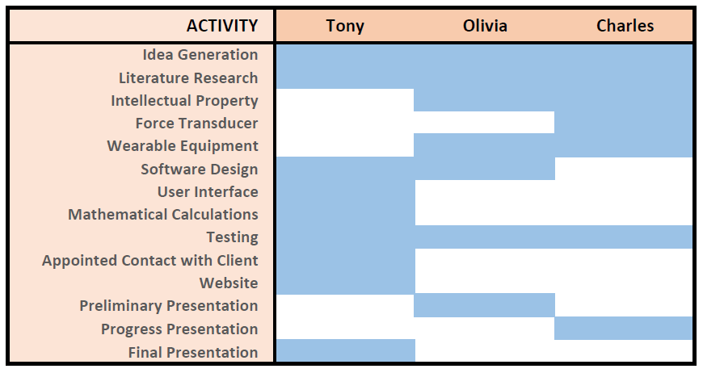
Group Responsibilities
21

Slide 22
Acknowledgements
Dr. Jack Engsberg
Tony Wang
Charles Wu
Dr. Joseph Klaesner
Anna Boone
Dr. John Standeven
22
Notes:
1. Hello, my name is Olivia Sutton and I am working with client Dr. Jack Engsberg, an occupational therapist at Paraquad, and my team of Tony Wang and Charles Wu to find a method to effectively quantify spasticity.
2. So, this project aims to diagnose spasticity, but what is that?
Spasticity is a symptom, not a disease, and it is commonly found in patients with cerebral palsy. Cerebral palsy is a general term for a group of non-progressive movement disorders that cause physical disability, mainly in the areas of body movement. There can be greater problems associated, from depth perception issues to communication difficulty. Cerebral palsy is caused by damage to motor control centers of the developing brain, and can occur during pregnancy, childbirth, or early childhood. Cerebral palsy itself is permanent, has no cure, and it affects one in five hundred children. Out of those, over 80% of CP patients have some degree of spasticity. Officially defined, spasticity is a velocity dependent resistance to passive muscle stretch, and in a patient, this causes an unusual tightness of the muscles or exaggerated reflexes. This picture shows a common gesture of spasticity, with all of the joints tense and curled inward. Some patients are curled up almost all of the time, and some only experience spasticity when their muscle is stretched very quickly.
3. So how do you objectively quantify the amount of spasticity in a patient? Currently, you don’t. Clinics around the country use the Modified Ashworth Scale to diagnose spasticity, which is truly nothing more than subjectively rating perceived spasticity on a scale of 0 to 4 by a physician. 0 indicates a patient with no spasticity, and 4 is like the picture on the earlier slide, where the patient is constantly tensed up and cannot move the muscle.
4. In this test, the physician stretches a joint of a patient at varying speeds to test the spasticity of a particular muscle. The physician then gauges how spastic the muscle is by ranking it on the Ashworth scale. It’s very subjective, and can vary from physician to physician, test to test, etcetera, making it both inaccurate and unrepeatable and therefore not a very scientific value.
5. Another test used in clinics is the deep tendon reflex test. This test is also subjective in nature, and similarly to the Modified Ashworth Scale, it is graded on a scale of 0 to 4. Instead of stretching the muscle passively, however, the muscle tendon is briskly tapped to elicit a reflex and then the physician judges the degree to which the muscle responds. On this scale, 2 indicates a normal reflex, with 0 referring to no reflex and 4 referring to a repeating or excessively brisk response. Both ends of the scale are thus abnormal responses. Exaggerated deep tendon reflexes is a symptom of spasticity in cerebral palsy patients, and can be used to assess spasticity. However, it is even harder to truly get a quantitative assessment of spasticity using this test as it is extremely qualitative in nature.
6. So, if the Modified Ashworth Scale is what has been working for decades, why do we even need to quantify spasticity? Well, although cerebral palsy cannot be treated, its symptoms including spasticity CAN. However, some of the treatment options are invasive surgeries marred by life-threatening or debilitating side effects and should only be applied in very specific cases. Having a quantitative measure for it is necessary for objective treatment planning.
7. Our project will aim to fill this gap. We will design a cheap, portable device or software that can quantitatively measure the three important factors of spasticity, including range of motion, velocity, and force. Our ultimate aim is to have our device replace the Modified Ashworth Test in clinics around the country.
8. In the past, there have been a few attempts to develop quantitative approaches to measuring spasticity proposed in the literature. One such study by Ansari developed a methodology where the patient’s arm is rotated about the elbow joint with a constant force. The instantaneous velocity is tracked during the movement and the reduction in velocity is calculated. This reduction in velocity is an indicator for spasticity--the greater the velocity reduction, the higher the spasticity. While it did work for some patients, this study failed to accurately measure patients in upper ranges of spasticity. Also, obtaining the instantaneous velocity to the degree at which this methodology requires is rather simple in a laboratory setup, but in a clinical situation without large expensive equipment, this proves to be a much more difficult solution.
9. Another of the existing quantitative spasticity measurement devices combines an EMG machine with a goniometer that records real time velocity and angle measurements. The data can then be integrated into a spasticity evaluator module that will output a quantitative value for spasticity.
This method however, includes many components and will take a relatively long time to set up. The placement of the EMG electrodes have to be very precise and the goniometer device has to be firmly strapped on in order to not be affected during arm movement. Other EMG methods exist, many of which do not even involve moving the joint during testing. However, these tests provide incomplete data as spasticity is the result of a dynamic process, not a static one.
10. Another quantitative study looked specifically at the ankle joint by moving it up and down through its range of motion and analyzing the force at all timepoints. They were able to observe a “catch” in the muscle movement during the study, where the muscle suddenly undergoes a strong spasm and “seizes up”, stiffening the joint and thus preventing any movement for a short time period. The study provided valuable data, but failed to arrive at a measurable scale to quantify degree of spasticity.
11. In this last quantitative study, conducted by our client, Dr. Engsberg, the leg was rotated about the knee joint at constant velocity using a KinCom dynamometer, while the force at any given time was tracked. The patient sits in the chair with their leg strapped into a dynamometer, which can move the leg at a regulated constant angular velocity. From this, the total work was calculated at various velocities.
12. The slope of the resulting work-velocity graphs in this study can be used to quantify different degrees of spasticity. Normal patients would have a rating of 0, and spastic patients would have a rating greater than 0, with the magnitude directly correlated to the degree of spasticity. In other words, the more spastic the patient, the higher the rating would be.
These torque-angular velocity graphs demonstrate the data acquired directly from the dynamometer. On the right, a spastic patient is shown, where for increasing velocity, there is an increasing amount of torque exerted to restrict the joint angle from increasing. On the left, it can be seen that for a non-spastic patient, there is no variance in these values.
Although this study successfully created a quantitative measure of spasticity that is a huge improvement over the Modified Ashworth Scale, the KinCom machine needed to do so was very expensive, on the order of hundreds of thousands of dollars, and the time needed to conduct the test is too great for the method in this study to be clinically feasible.
13. So, in order to make sure the device our team builds not only works, but is clinically feasible, we have to pay attention to a lot of different design requirements, including
The weight of this device, which has to be less than 1 kg to allow the physician to easily use it on the patient.
The size of the device, which has to be no larger than 21.6 x 19 x 5 cm, which is about the average size of the physician’s pocket
The cost has to be less than $200, since the most widely used clinical test currently costs nothing and in order to compete with it, we need to have a cheap device that can be purchased by clinics regardless of wealth. These three were the main downfalls of the KinCom method, and we aim to improve.
Also unlike the KinCom, the device has to be portable, meaning it does not require a constant power supply or a stationary component, so that it can be easily transported between patient rooms.
The battery life must not require charging over a period of 8 hours, which is comparable to the average workday, assuming the device is used on one patient every 30 minutes at maximum
14. Some other requirements include ease of use, usage time, data storage, accuracy and precision
The device has to be easy to use and it must have a very intuitive interface and cannot require more than 10 minutes of training for a physician to effectively use.
The Usage Time for the device should be similar to that of a regular Modified Ashworth test, and the length of test for a single joint should not take more than 5 minutes, including setup of device, data acquisition, and data saving
The Data Storage would ideally be less than 0.3 megabytes per test, since it is just purely numbers in a text file, which can then easily be incorporated into a formula to give us an index of spasticity
We are hoping that this method would be more accurate and able to differentiate between different levels of spasticity at a greater level of precision than the Modified Ashworth Scale, meaning we have to be able to present a scale more than five categories of distinguishable spasticity.
The error of a test like this should be less than 10% between repeated trials on the same patient on the same joint for this device to be useful. The repeatability of the Modified Ashworth Scale has consistently proven to be very poor, and whatever device we build should aim to improve this significantly. This would be the main selling factor of a device like this, and is needed to convince a clinic to change its ways and attempt to implement a new technology rather than sticking to its ways.
15. The data acquired from the smartphone and force transducer will have to be transmitted to the computer for data storage and analysis. There are two obvious methods in which to do this, namely, Bluetooth and wifi.
Both of these methods operate around the same frequency, but bluetooth is much lower in cost than wifi.
The main difference between the two is that bluetooth transfers data at a slower speed than wifi since it has a lower bandwidth (800 Kbps compared to 11Mbps), but that is not an issue for this project, since the data acquired in one test does not take up much space. Namely, we aim to use 0.3 megabytes of data per test as shown in the previous slide. Since this file size is so small, either method would be appropriate.
The range of transmission is comparable between the two, with Bluetooth needing to be a little closer in some scenarios, and in our situation, the devices would certainly be within five meters anyway.
The bit-rate is also lower for bluetooth, but then again, since the data does not take up too much space, either way would be appropriate for our purposes.
16. This calculation shows the amount of time needed for data transmission, and we see that even using Bluetooth with an 800kbps bandwidth we can transfer 300kb of data, which is our target maximum file size, in just under half a second. Wireless will be able to do so much quicker, but neither is time consuming enough to limit our decision.
17. So now that we’ve looked at all of the necessities for the device itself, let’s look at what it has to do. There are three major components that factor into the measurement of spasticity. The first is range of motion. For example, highly spastic patient will have a very limited range of motion as the muscles are tense all of the time and limit them.
The second and third are the velocity of motion, and the force generated by the spastic muscle at a particular velocity. These are accounted for qualitatively by the Modified Ashworth Test. At higher velocities of passive muscle stretch, the force generated by the spastic muscle will increase, hence decreasing the velocity until the point at which the patient’s range of motion ends.
These values are hence very intertwined, and our device will have to measure all of these simultaneously.
18. This is a diagram I made up to represent the scenario that will occur before and during one of these tests. In particular, it shows the force that is exerted on the leg when the leg is at rest and during passive muscle stretch. Now let’s look at the zoomed in view.
19. The diagram on the left shows when the leg is at rest, and equation 1 on the right reflects the forces present, which is simply Fgravity = Fjoint.
The two equations below are applicable to the rightmost image, when the physician is moving the limb to passively stretch the muscle. Two new forces are introduced, the applied force and the spastic force, working opposite of one of one another. This picture well summarizes the problem at hand, and what we have to work to measure.
20. In order to make this device happen, we have created a tentative design schedule, in the form of a Gantt chart broken down by week. We plan to identify which route we want to take with this project after the coming week, and begin work on programming and building the actual device starting then through the rest of the semester. We aim to implement the hardware and software and enter a testing phase near the end of October, so that our device can be ready to undergo safety testing before our final report in early December. Throughout the project, we will be meeting weekly with Dr. Engsberg who will evaluate our progress.
21. And here is how we divided up our work within the group. We tried to assign at least two members of our group to working on each of the design and programming components of the project so that more than one member’s ideas would be going in to each part. All three of us will contribute to the idea generation and preliminary research, as well as product testing, while each of us will separately present our ideas once over the semester.
22. Thank you very much for listening, and I’d like to open up the floor for questions!

