Slide 1
Spasticity Quantification
Tony Wang
with Olivia Sutton and Charles Wu
Group 11
Final Presentation
December 5, 2014

Slide 2
The Need
Millions of people in the United States alone have some degree of muscle spasticity
Can result from cerebral palsy, seizures, injuries to brain or spinal cord
Characterized by the velocity-dependent resistance of muscle
Must be able to measure muscle spasticity to determine patient-specific treatment options
Physical therapy
Pharmacological drugs to reduce spasticity
Notes:
Tony
Incorporate MAS into need

Slide 3
Current Methods
Modified Ashworth Scale
Description: Current standard examination that qualitatively characterizes spasticity
Pros:
Cheap, convenient, easy, versatile
Cons:
Very inaccurate and unrepeatable
Hard to gain the intuition required to perform well
“Engsberg Method”
Description: KinCom dynamometer was used to measure force, range of motion, and velocity to quantitatively characterize spasticity
Pros:
Objective, accurate, reproducible
Cons:
KinCom is not portable, expensive, occupies large space
Engsberg et al. (1996). Archives of Physical Medicine and Rehabilitation.
Notes:
right side, present Engsberg method-- new gold standard if our device works...

Slide 4
Project Scope
Design a device (hardward + software) that:
Measures resistance to movement (force), range of motion (angle), and velocity
Incorporates three parameters into one final spasticity value
Is accurate, reliable, and reproducible
Is low cost to build
Is portable, small, light-weight
Notes:
Tony

Slide 5
Design Analysis
Characteristic | Original Specification | Outcome
Cost | < $200 | $74.39
Portability | Lasts at least 10 hours | Lasts 27 hr
Accuracy of FSR | < ±1N | ±0.2N
Accuracy of Accelerometer | < ±0.05g | ±0.0153g
Accuracy of Velocity | < 5% | < 2.5%
Reliability of FSR | < 10% between trials | 2% between trials
Reliability of Accelerometer | < 10% between trials | 0.28% between trials
Size | < 21.6cm x 19cm x 5cm (average size of a physician’s coat pocket) | 13.5cm x 8cm x 8cm and can be disassembled
Notes:
combine into 1-2 slide, point out some important things

Slide 6
Design Analysis
Characteristic | Original Specification | Outcome
Weight | < 0.5 kg | 0.432 kg
Training | < 10 minutes | < 10 minutes
Versatility | Accommodate limb size of 15 cm to 45 cm in circumference. Measure force from 0N to 200N. | Accommodates limb size of 13cm to 35cm in circumference. Measures forces from 0N to 200N.
Durability | Withstand 200N in compression and 30N in tension | Withstands > 200N in compression and 60.48N in tension
Ease of Use | Duration < 10 minutes | Depends on # of tests, but likely < 10 min
Frequency | > 10 Hz | 10 Hz
Power Consumption | < 1 W | 0.25W
Range | < 5 m away | 10 m away
Memory | < 2 kilobytes | 2 kilobytes
Bandwidth | < 2 Mbps | 2 Mbps
Notes:
Olivia

Slide 7
Final Product

Slide 8
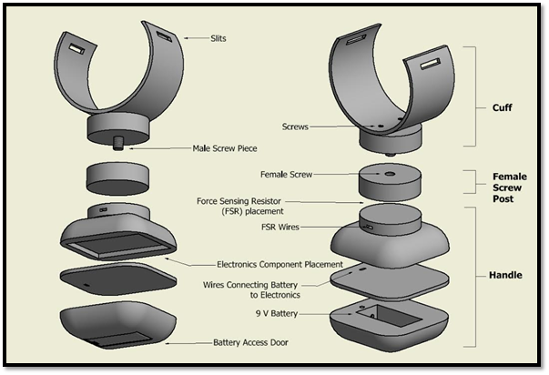
Final Design
Part | Cost | Manufacturer
Handle including Battery Cover | $12.09 | Proto Labs
Handle Assembly Glue | $0.03 | IPS Corporation
Velcro | $0.56 | VELCRO
Flexible Cuff | $3.50 | Inventables
Female Screw Post | $2.35 | Proto Labs
Male Screw Piece | $4.46 | Proto Labs
Elastic Strap | $0.30 | Dritz
Double Sided Tape | $0.42 | 3M
Screws | $0.54 | Grainger
TOTAL: | $24.25
Notes:
RIght side; put table there. part name, price, company/manufacturer.
Talk through the materials for the design, shape retaining plastic for the cuff and ABS plastic for the rest
screw for different sizes,compatible for limbs of any size circumference range. wrists range:13-20cm, ankle range 20-35cm in circumference. so one cuff will be 13 cm and the other 20cm in length
relative dimension: handle: 8x8x5cm, cuff, 5cm wide and like 8cm tall

Slide 9
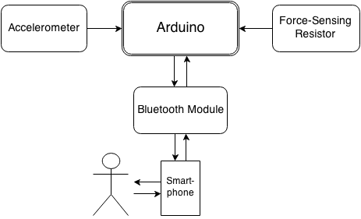
Software General Layout
Part | Cost | Manufacturer
Arduino | $19.99 | Arduino
Battery Terminal Connector | $1.29 | Sparkfun Electronics
Bluetooth Module | $6.65 | Bluetooth
Wire | $0.08 | Radioshack
Accelerometer | $14.95 | Sparkfun Electronics
Force Transducer | $5.50 | Interlink Electronics
Battery | $1.68 | Energizer
TOTAL | $50.14
Notes:
Tony

Slide 10
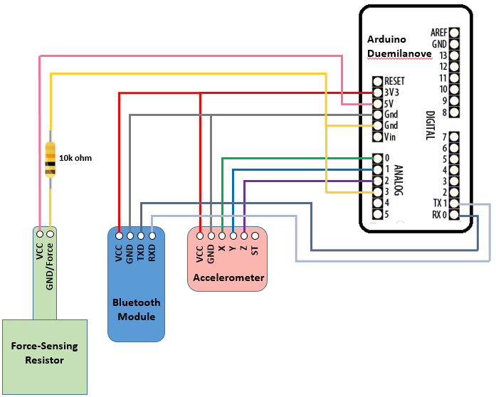
Circuit Diagram
Notes:
Tony

Slide 11
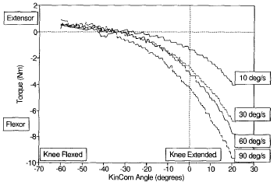
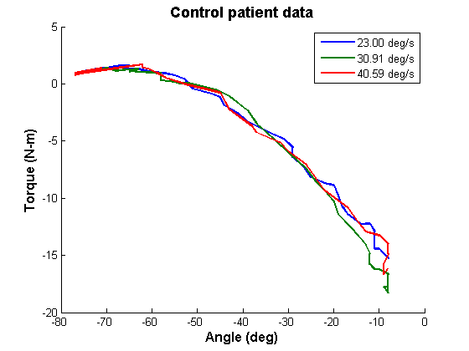
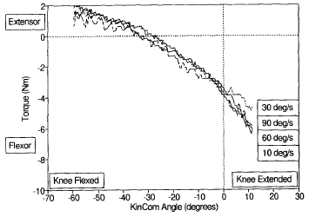
Collecting Data
Engsberg et al. (1996). Archives of Physical Medicine and Rehabilitation.
Notes:
right side, put Engsberg plots for control, spastic

Slide 12
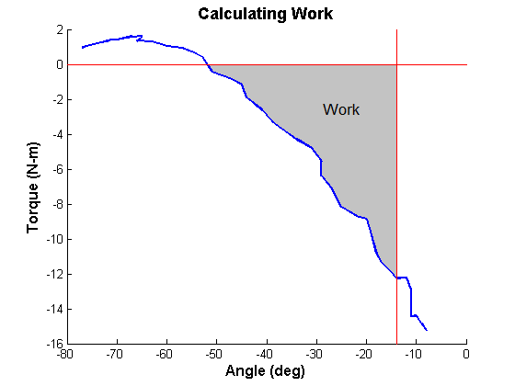
Calculating Work
Notes:
add shading/lines

Slide 13
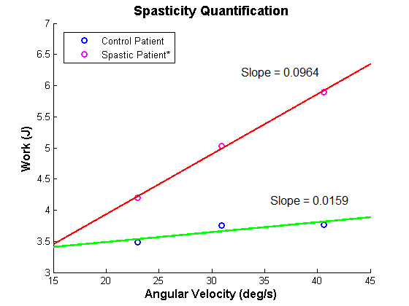
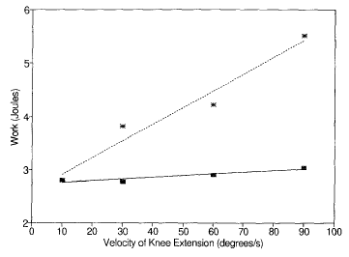
Linearization (Spasticity Value)
Engsberg et al. (1996). Archives of Physical Medicine and Rehabilitation.
* hypothetical data
Notes:
have Engsberg plot on right, show spastic data as well, y axis should say “work”

Slide 14
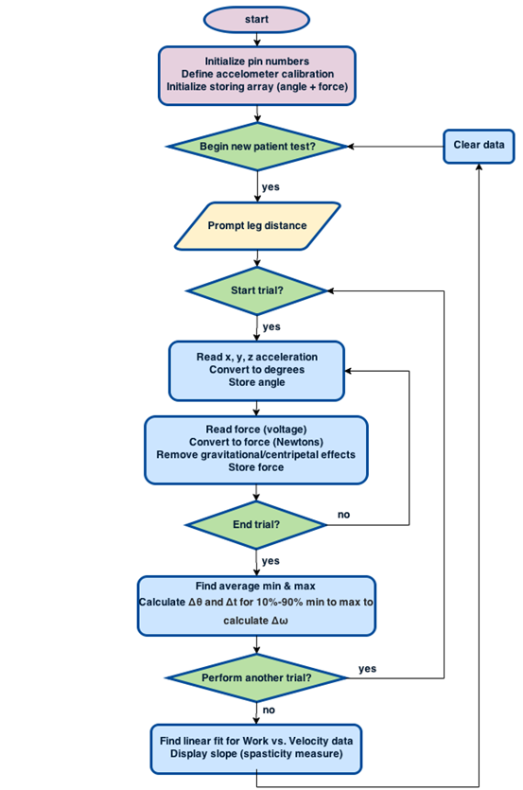

Slide 15
Safety and Ethical Considerations
Chemical
Use of alkaline batteries presents unlikely risks of exposure to dangerous chemicals
Battery usage warnings included with device
Electrical
Water exposure presents unlikely risk of sparks or shorting
Waterproofing will occur, isolating electronics from the elements
Mechanical
Incorrect testing methods can cause injury to the physician or patient
Thorough video and written instructions for device usage will be included with device
Diagnostic
Incorrect testing without retesting or incorrect data interpretation could lead to unnecessary side effects of an incorrect diagnosis
Notes:
mention a couple important safety

Slide 16
Conclusions
Prototype accomplished:
Measured force, angle, and velocity accurately and precisely
Integrated three components together and used novel methodology to quantify spasticity
Durable, portable design and intuitive to use
Costs only $74.39
Intellectual Property
Physical Device: Utility Patent
Method of spasticity quantification: Utility Patent
Software: Trade Secret
Distribution channel initially through hospitals, physicians, clinics
Notes:
what did prototype succeed at? mention prototype failures. what are future directions?
exceed expectation in terms of how far along we progressed
include final cost, include something on customer base

Slide 17
Conclusions
Learned to:
Assemble a team of diverse talents
Communicate professionally with professors and companies to help with custom parts, resolve technical issues
Things we would have changed:
Avoid constricting ourselves to one original idea
Most intuitive design is not the always the best design
Future directions:
Conduct clinical trials to differentiate between different spasticity levels
Client wishes to further develop and market device, with our group retaining 60% of all future profits
Notes:
make teamwork and learned to more specific
For it to be IP, it has to be considered useful, new and nonobvious

Slide 18
Acknowledgements
Dr. Jack Engsberg
Olivia Sutton
Charles Wu
Dr. Joseph Klaesner
Anna Boone
Dr. John Standeven
Rebecca Gilson
Patricia Widder

Slide 19
Questions?

